Slide 1
School of Computer Science & Engineering
AI Application Development – IA1
OptiClick SEO

Slide 2
Team members & roles
Team member name | Role
Jeyaprajan V | Team lead
Impana E Reddy Akhila | Development lead Developer
Jnanesh N R
Chetan Skanda
Disha S | Customer Contact Lead
Notes:
Talk about how they are managing their documents, how google docs does automatic versioning
As them what they know about Android and IoS versions

Slide 3
Modified Problem Statement
Businesses struggle to optimize their websites for SEO and AEO, leading to poor rankings and low visibility.
Existing tools require manual effort and lack automation, making the process time-consuming and inefficient.
Notes:
Talk about how they are managing their documents, how google docs does automatic versioning
As them what they know about Android and IoS versions

Slide 4

User/ Customer Understanding
We conducted discussions with industry professionals and potential users to understand real-world SEO challenges.
Participants
Harish Thimmegowda (Senior Director – Client Services, Availity)
Rekha Kosuru (Team Lead & Hiring Manager, Clean Harbors)
Students and website users
Key Findings
Lack of knowledge in SEO and AEO
Existing tools are complex and difficult to use
Manual optimization is time-consuming
Need for automated and easy-to-use solutions
Proof -
Notes:
Talk about how they are managing their documents, how google docs does automatic versioning
As them what they know about Android and IoS versions

Slide 5
Ideal Customer Profile (ICP)
Target Users
Demographic
Age: 18–40
Industries: E-commerce, blogging, digital marketing
Small business owners
Bloggers and content creators
Digital marketers
Psychographic
Pain Points
Lack of SEO and AEO knowledge
Difficulty improving website ranking
Manual optimization is time-consuming
Existing tools are complex
Use digital tools regularly
Prefer web-based platforms
Avoid complex systems
Expect quick results
Notes:
Only stress on the 1st sentence – the definition
Come back to the 2nd sentence in the end as part of revision

Slide 6
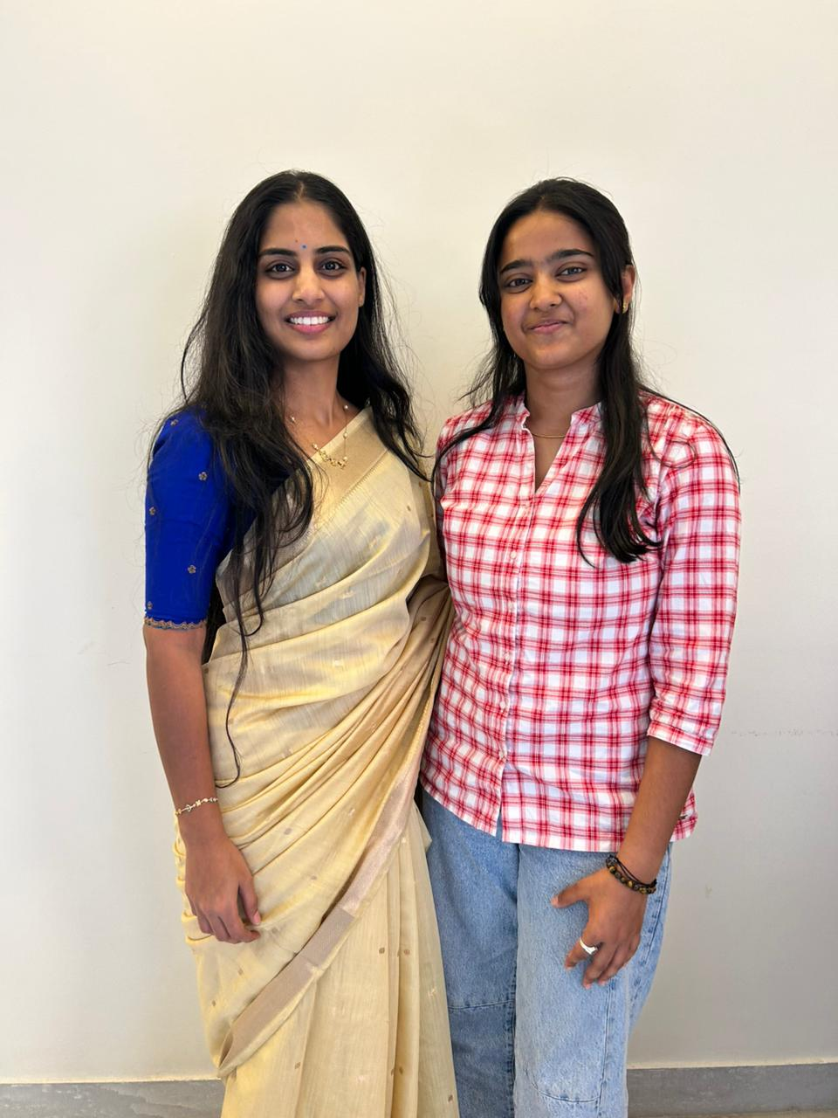
Customer Persona (CP)
Name: Rekha Kosuru Age: 32 Occupation: Team Lead & Hiring Manager Organization: Clean Harbors Location: Bangalore
Behavior:
Uses web tools regularly
Prefers simple and efficient systems
Avoids complex platforms
Needs quick and actionable insights
Goals:
Improve website visibility
Increase engagement and reach
Reduce manual SEO effort
Notes:
Only stress on the 1st sentence – the definition
Come back to the 2nd sentence in the end as part of revision

Slide 7
Product USP
AI-Powered Automated Analysis - Automatically analyzes website content
SEO + AEO in One System - Improves ranking and AI visibility
Reduced Manual Effort - Easy to use, no technical expertise needed
AI-Based Content Improvement - Generates FAQs and optimized content
Smart Recommendation Engine - Provides actionable suggestions to improve SEO score
One-Click Optimization – Instantly analyze and optimize website performance
Automated Content Update (Authorized Access) – Updates website content via AP/GitHub integration
Notes:
Only stress on the 1st sentence – the definition
Come back to the 2nd sentence in the end as part of revision

Slide 8
Use Cases & High level Requirements
Enter Website URL - User provides website link as input
Automated Website Analysis - System analyzes content, keywords, and structure
SEO Score Generation - System calculates and displays SEO score
Suggestions & Improvements - System provides automated SEO & AEO recommendations
Content Optimization Output - User receives improved content (FAQs, structured answers) \
Functional
URL input & website analysis
Issue detection (SEO & AEO)
AI-based suggestions
Automated content improvement
Dashboard display of results
Non-Functional
Fast Processing
Scalable system
User-friendly interface
Notes:
Only stress on the 1st sentence – the definition
Come back to the 2nd sentence in the end as part of revision

Slide 9
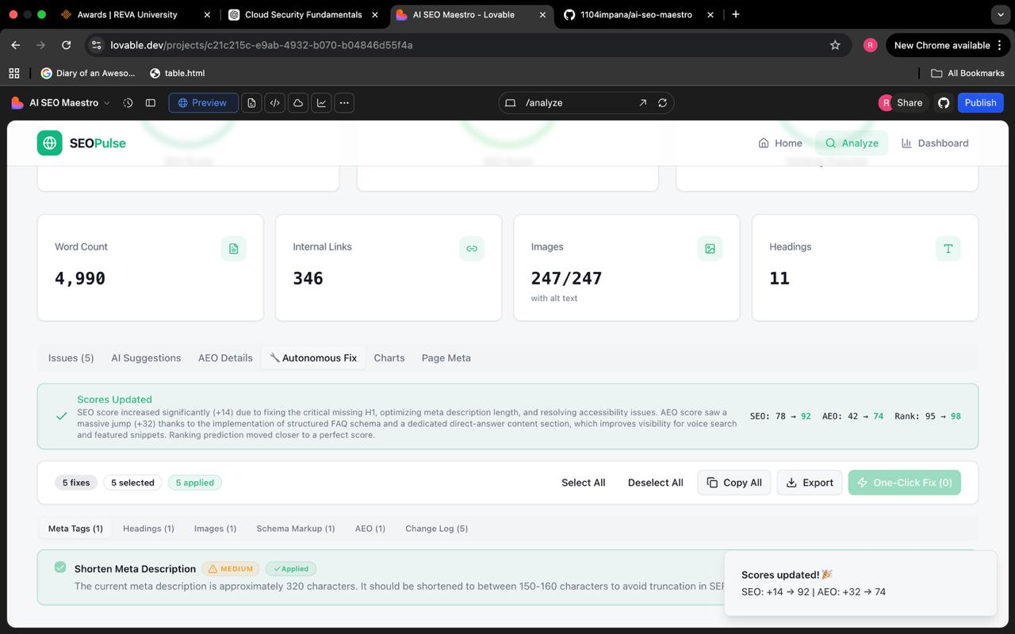
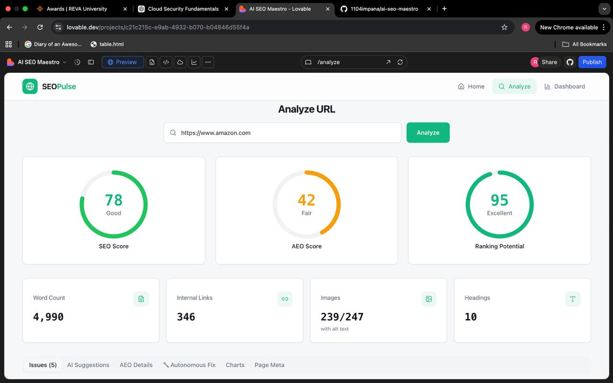
Proof of Concept (PoC) / Prototype Demo
Demo Link -
Notes:
Only stress on the 1st sentence – the definition
Come back to the 2nd sentence in the end as part of revision

